Slide 1
AIMS - AUTOMATED INVENTORY MANAGEMENT SYSTEM
USER MANUAL

Slide 2
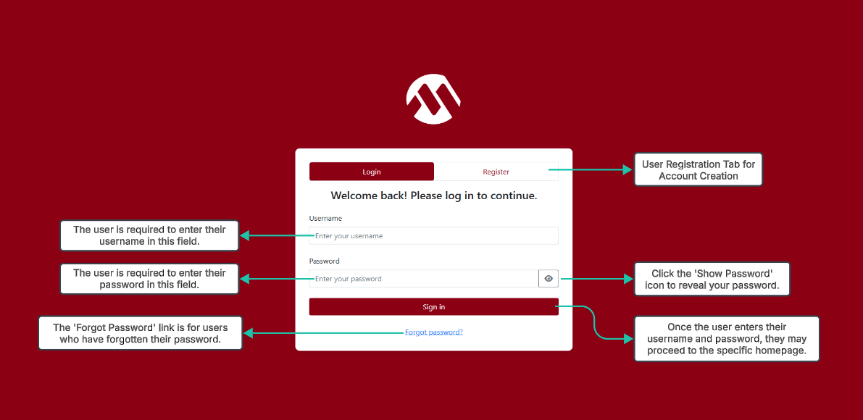
Account Login Tab

Slide 3
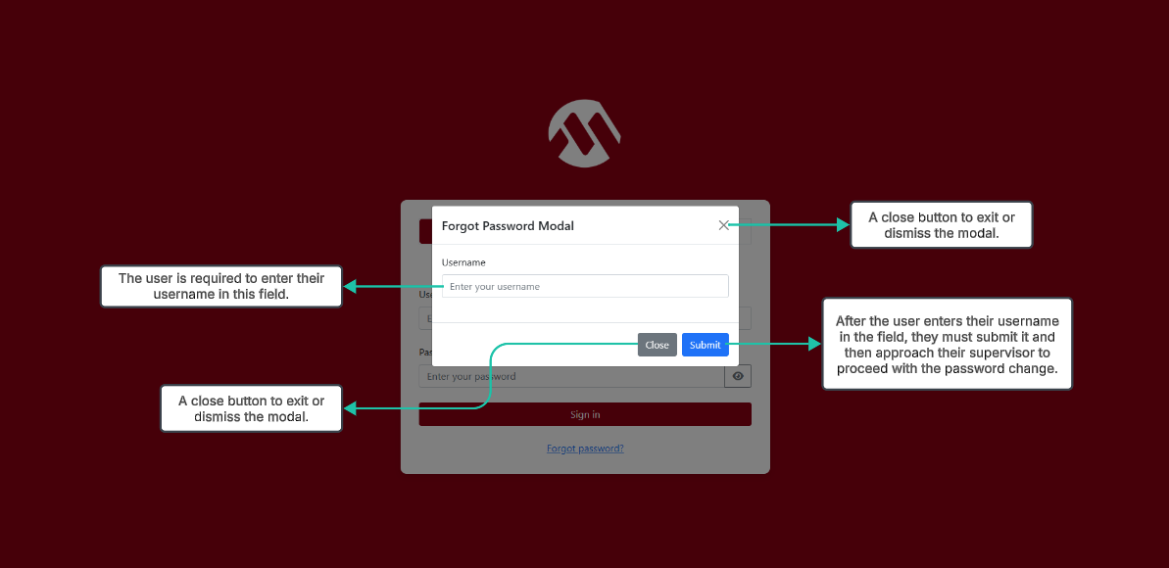
Forgot Password Link

Slide 4
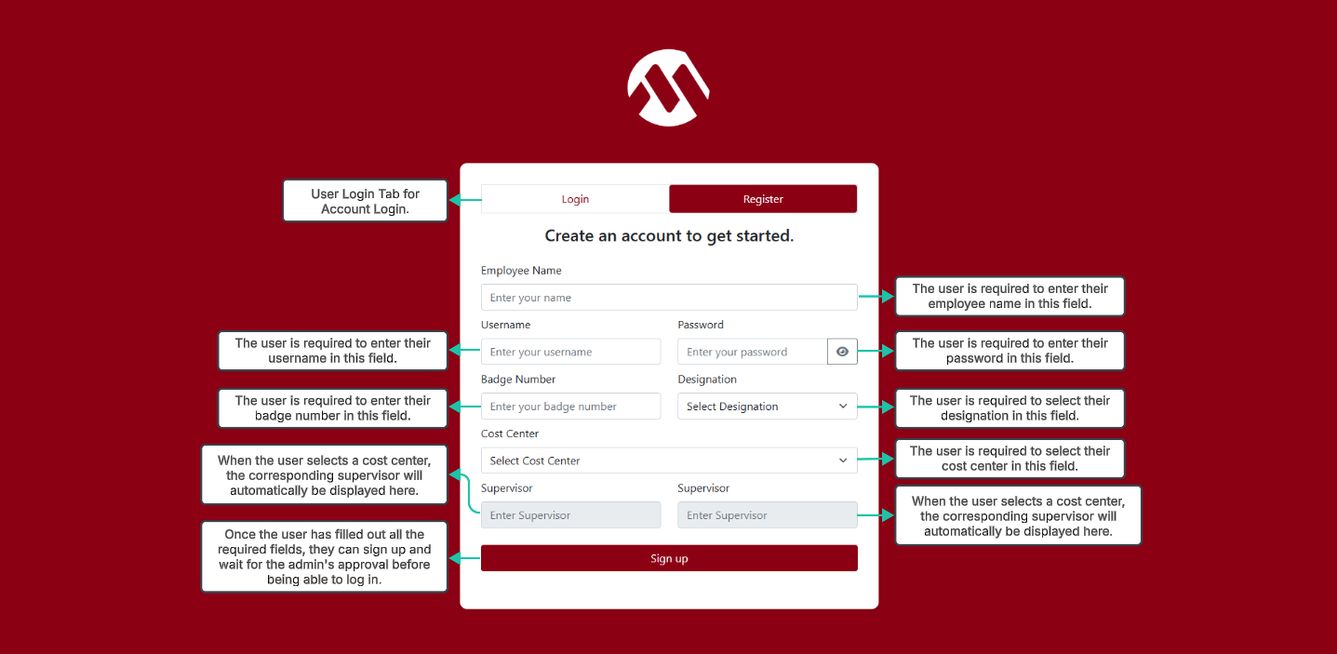
Account Registration Tab

Slide 5
USER MODULE

Slide 6
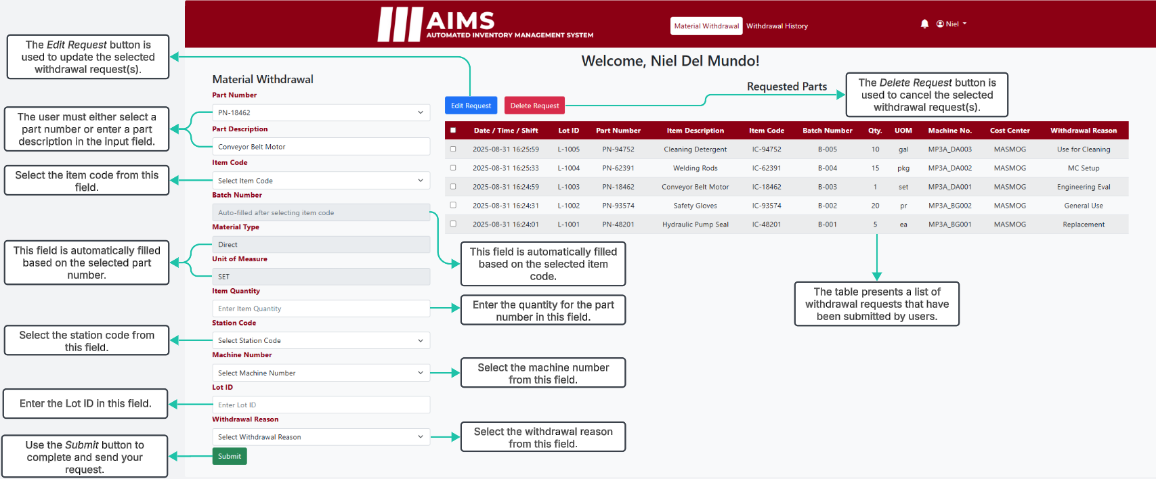
Material Withdrawal

Slide 7
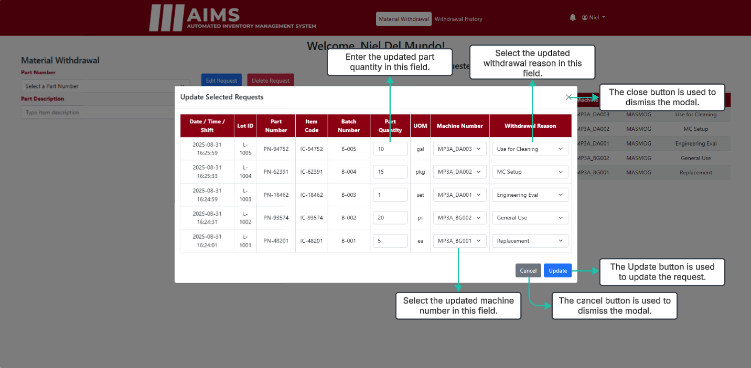
Material Withdrawal (Update Modal)

Slide 8
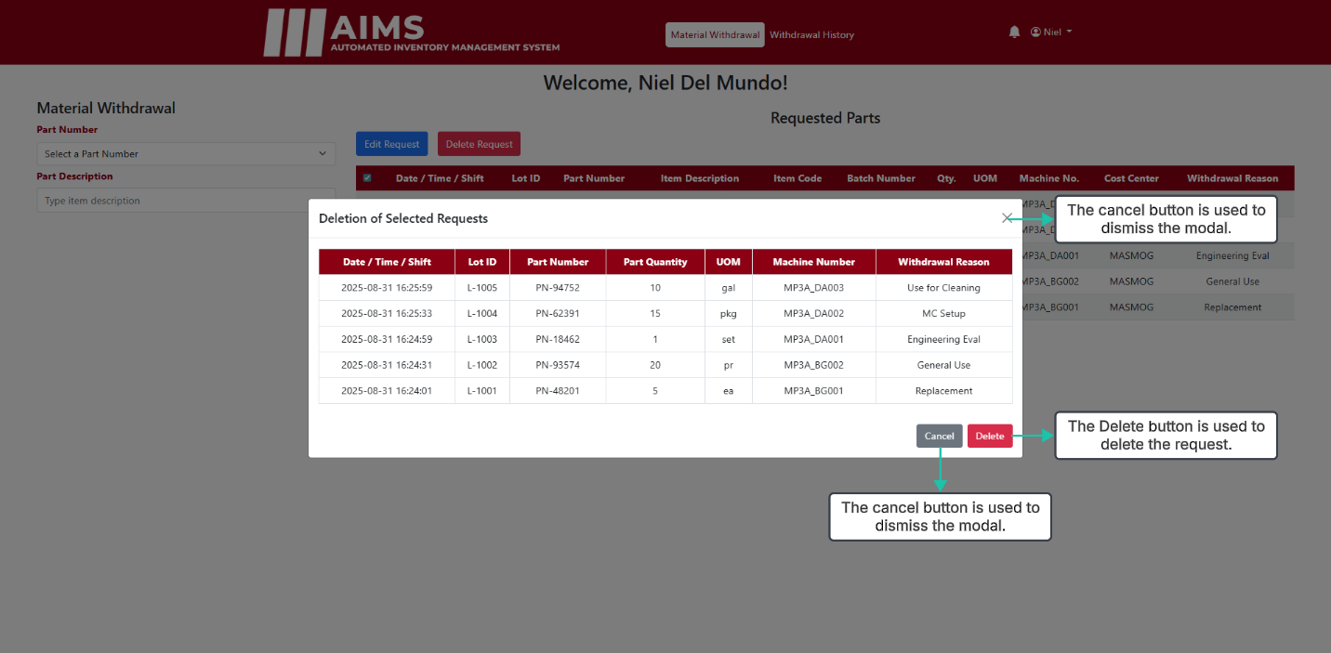
Material Withdrawal (Delete Modal)

Slide 9
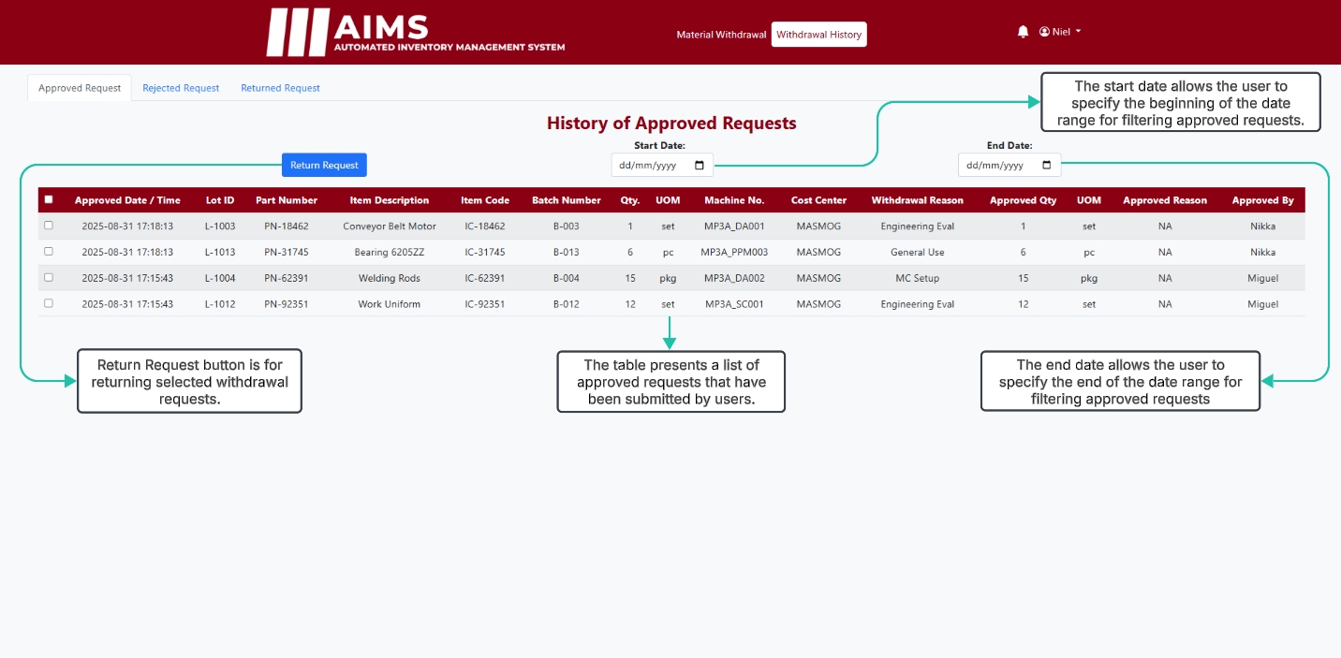
Withdrawal History (Approved Tab)

Slide 10
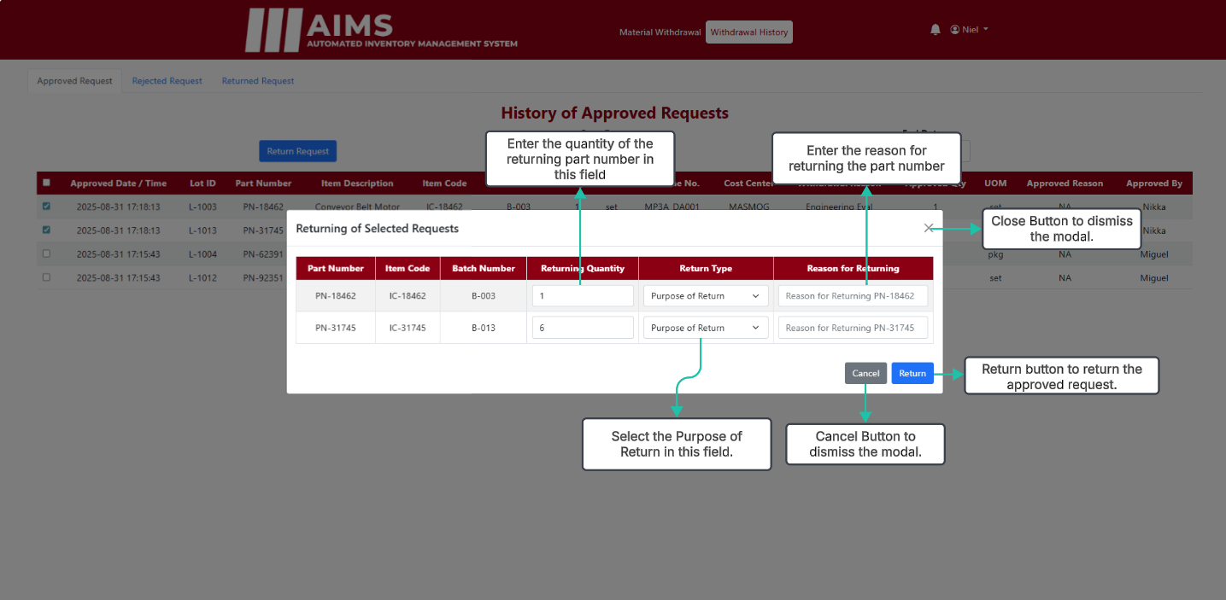
Withdrawal History (Return Modal)

Slide 11
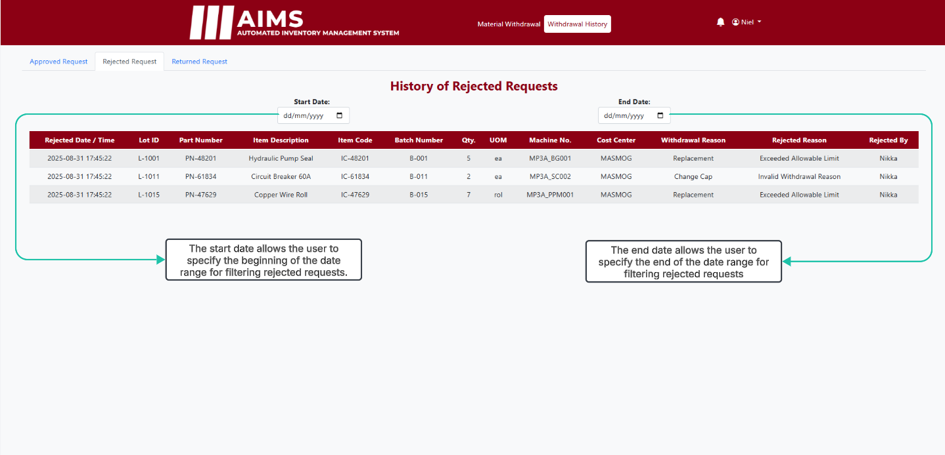
Withdrawal History (Rejected Tab)

Slide 12

Withdrawal History (Returned Tab)

Slide 13
SUPERVISOR / KITTING MODULE

Slide 14
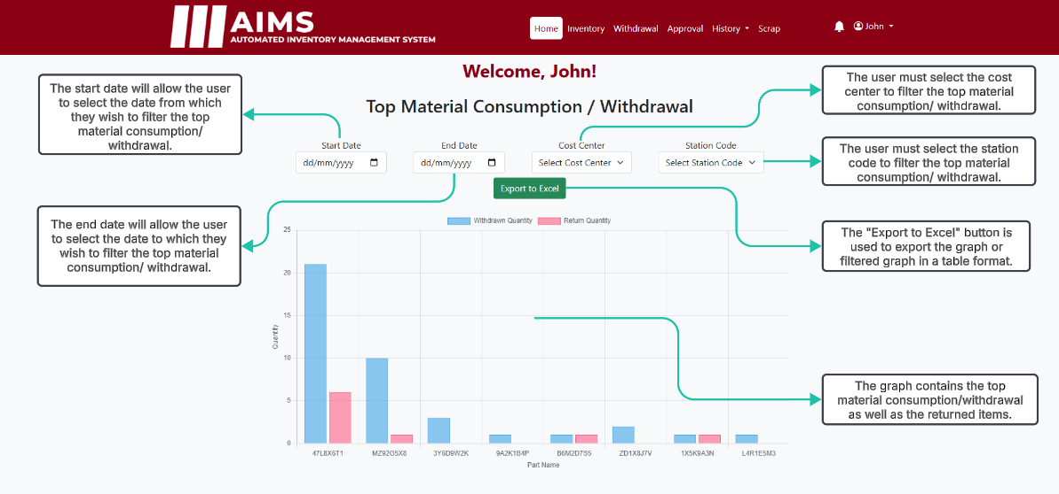
Supervisor / Kitting Dashboard

Slide 15
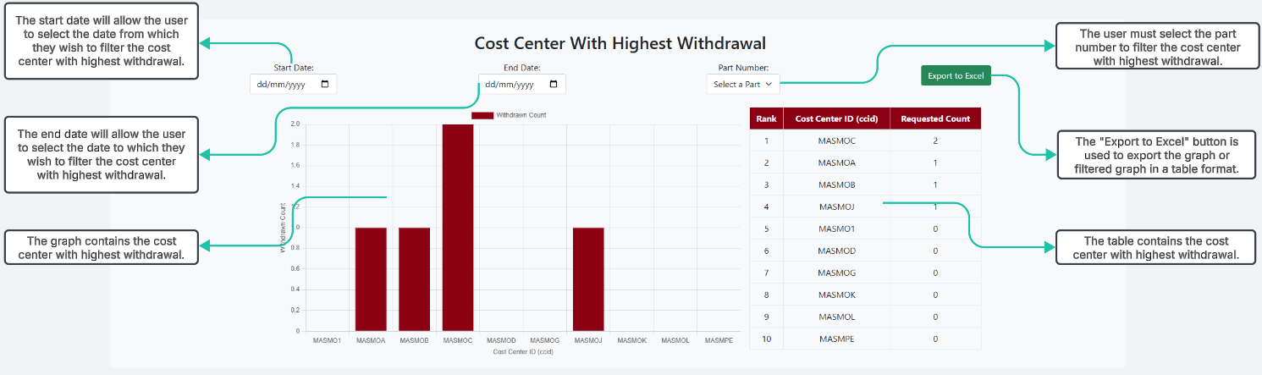
Supervisor / Kitting Dashboard

Slide 16
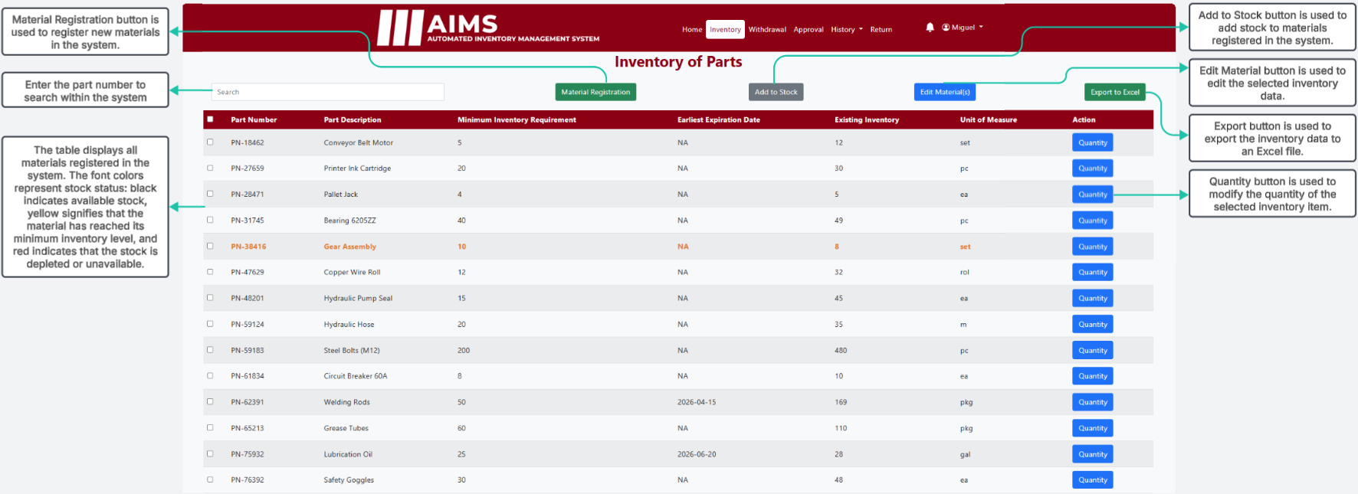
Supervisor / Kitting Inventory

Slide 17
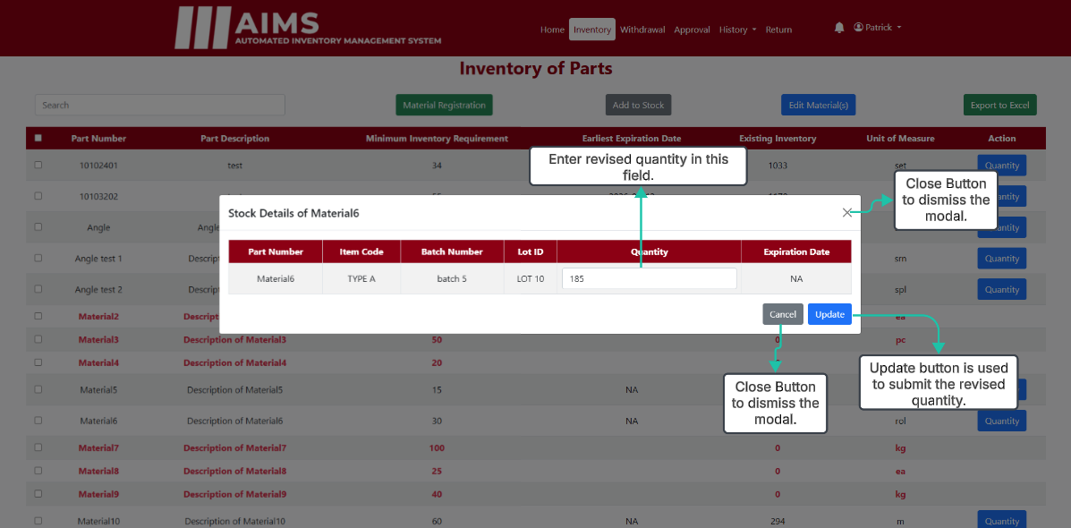
Supervisor / Kitting Inventory (Quantity Button)

Slide 18
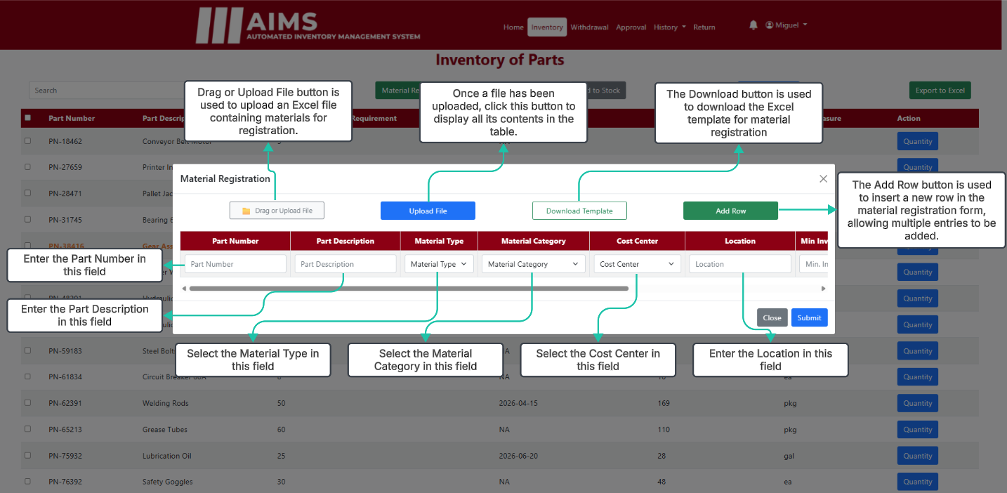
Supervisor / Kitting Inventory (Material Registration)

Slide 19
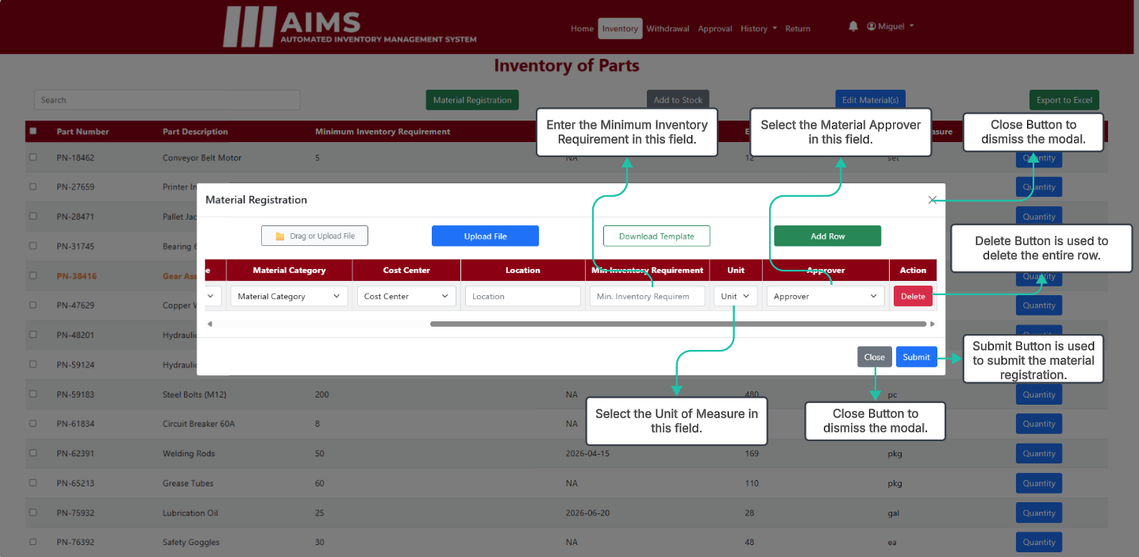
Supervisor / Kitting Inventory (Material Registration)

Slide 20
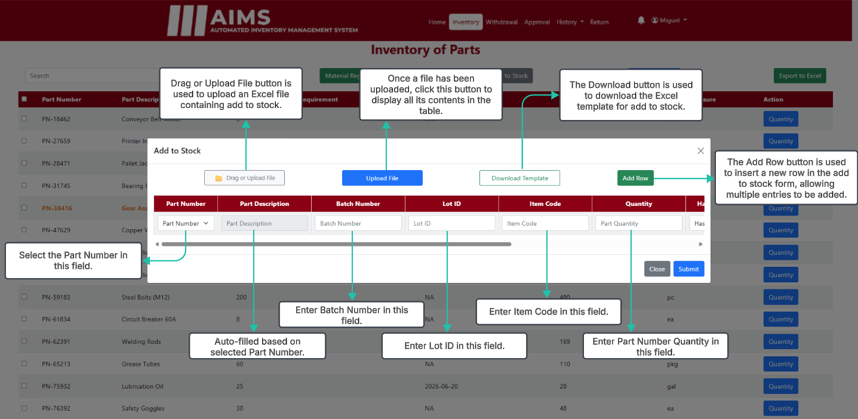
Supervisor / Kitting Inventory (Add to Stock)

Slide 21
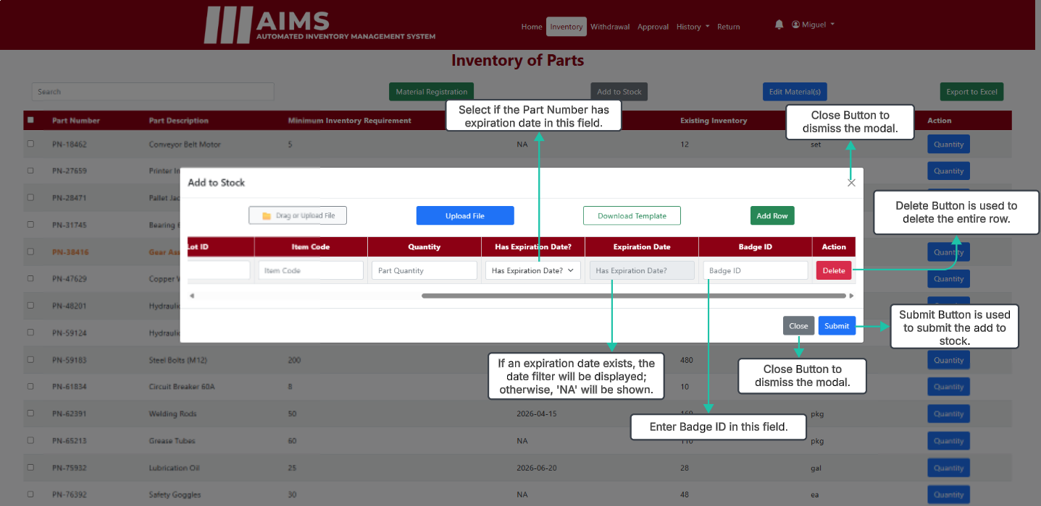
Supervisor / Kitting Inventory (Add to Stock)

Slide 22
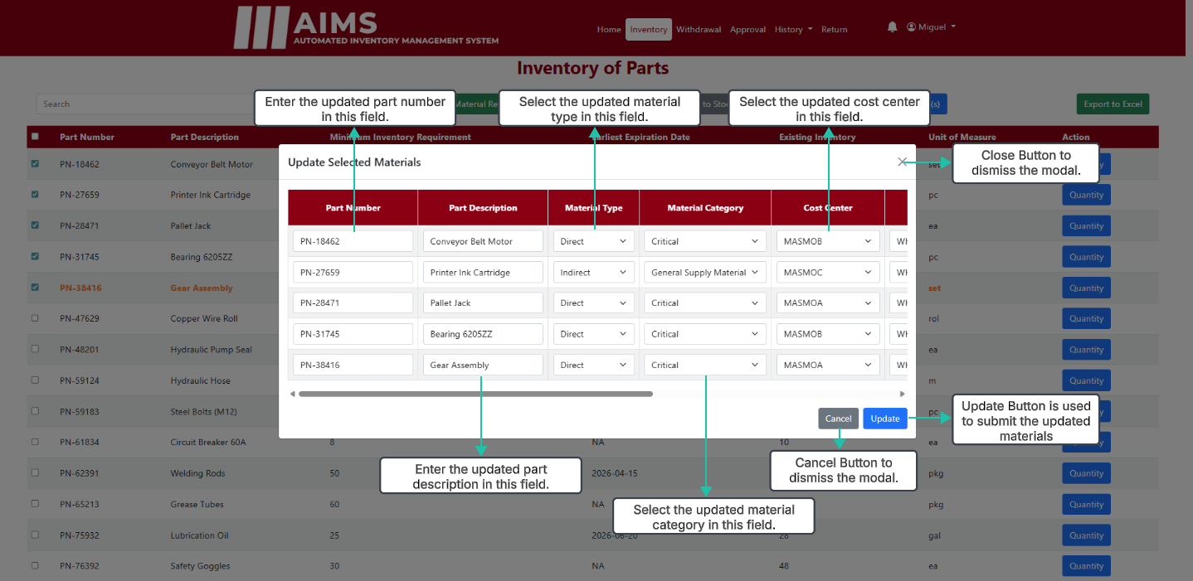
Supervisor / Kitting Inventory (Edit Button)

Slide 23
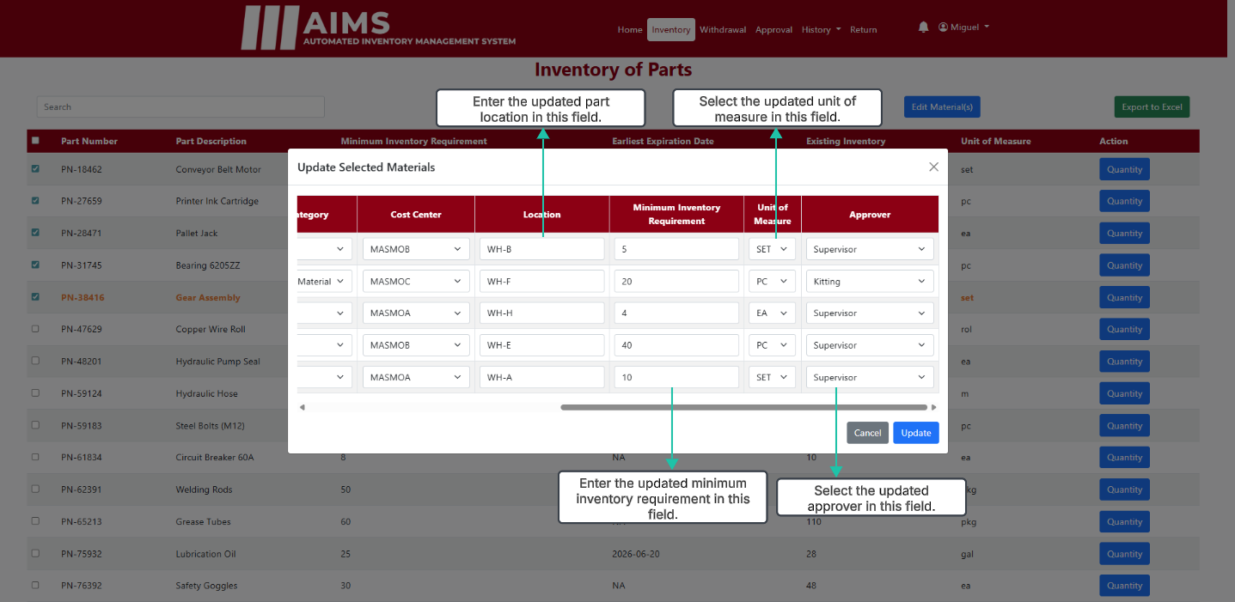
Supervisor / Kitting Inventory (Edit Button)

Slide 24
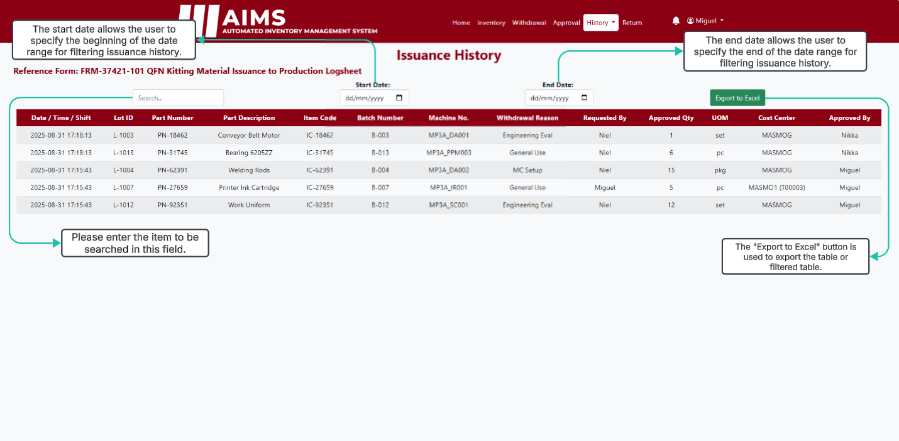
Supervisor / Kitting Issuance History

Slide 25
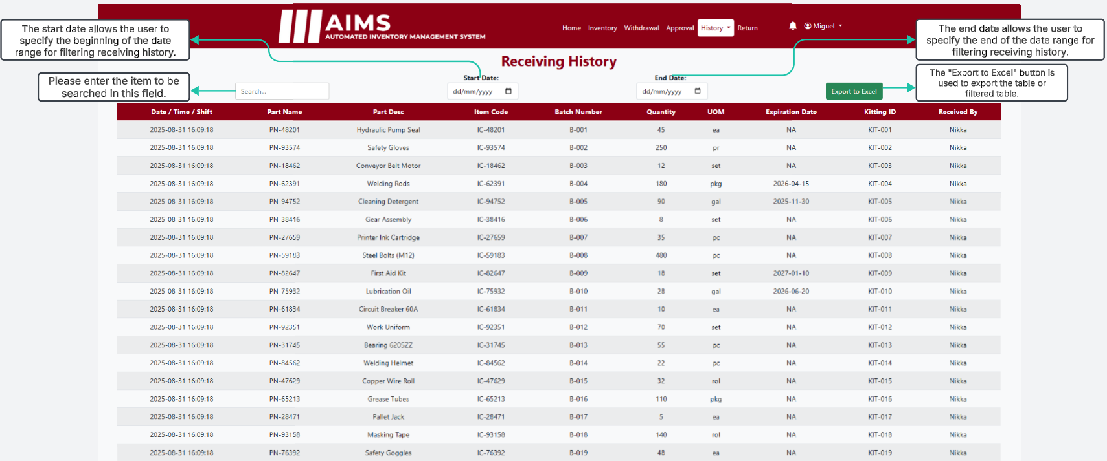
Supervisor / Kitting Receiving History

Slide 26
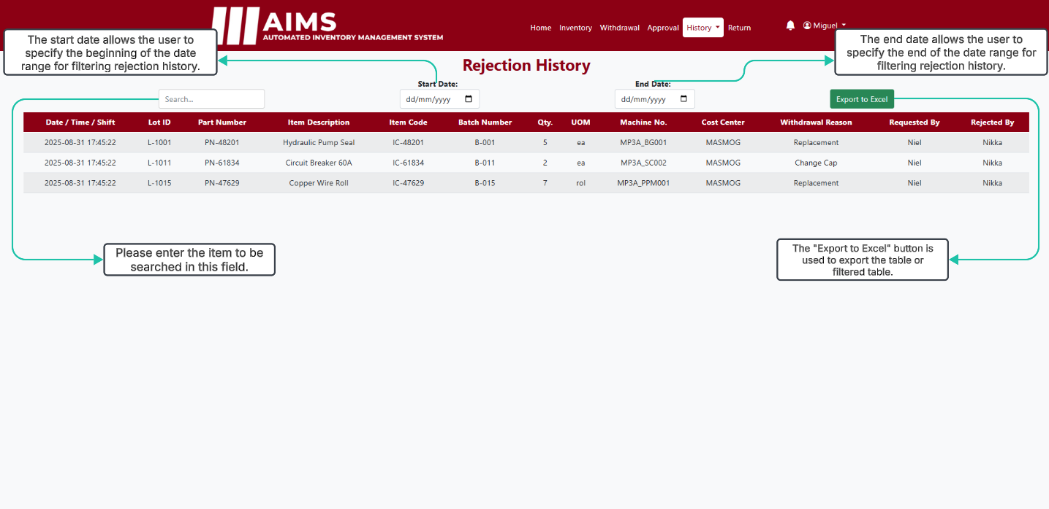
Supervisor / Kitting Rejection History

Slide 27
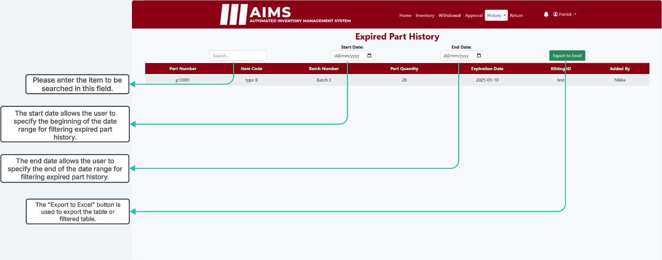
Supervisor / Kitting Expired Part History

Slide 28
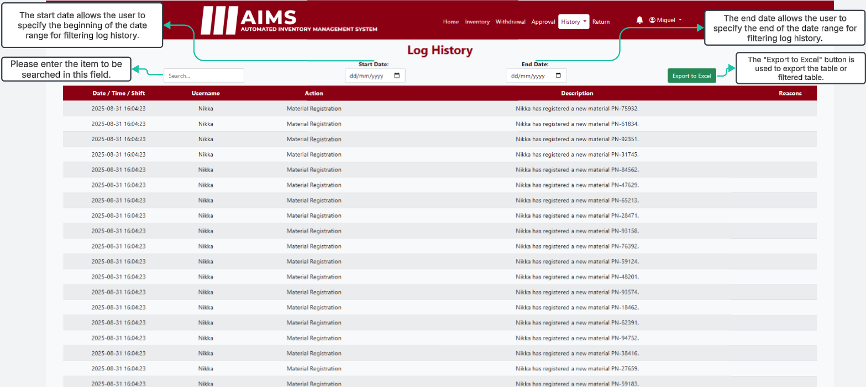
Supervisor / Kitting Log History

Slide 29
SUPERVISOR / KITTING / MAINTENANCE SUPERVISOR MODULE

Slide 30
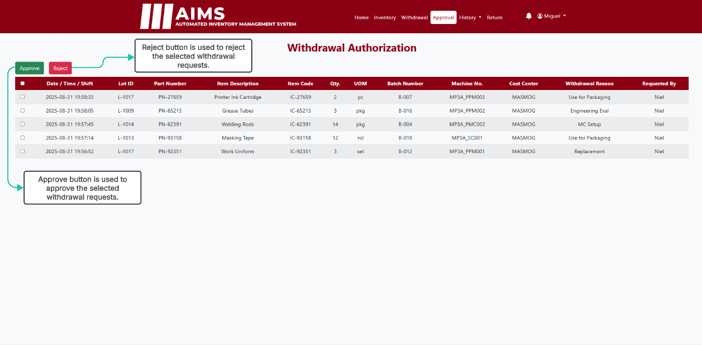
Approval

Slide 31
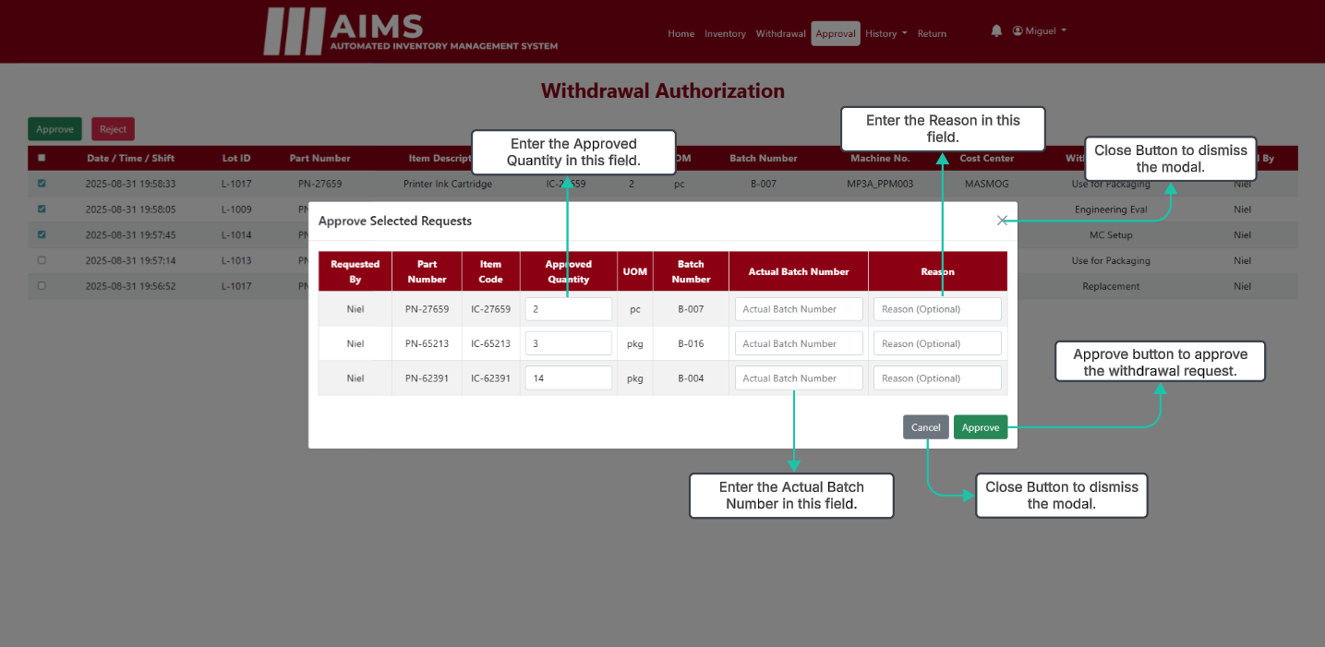
Approval (Approve Modal)

Slide 32
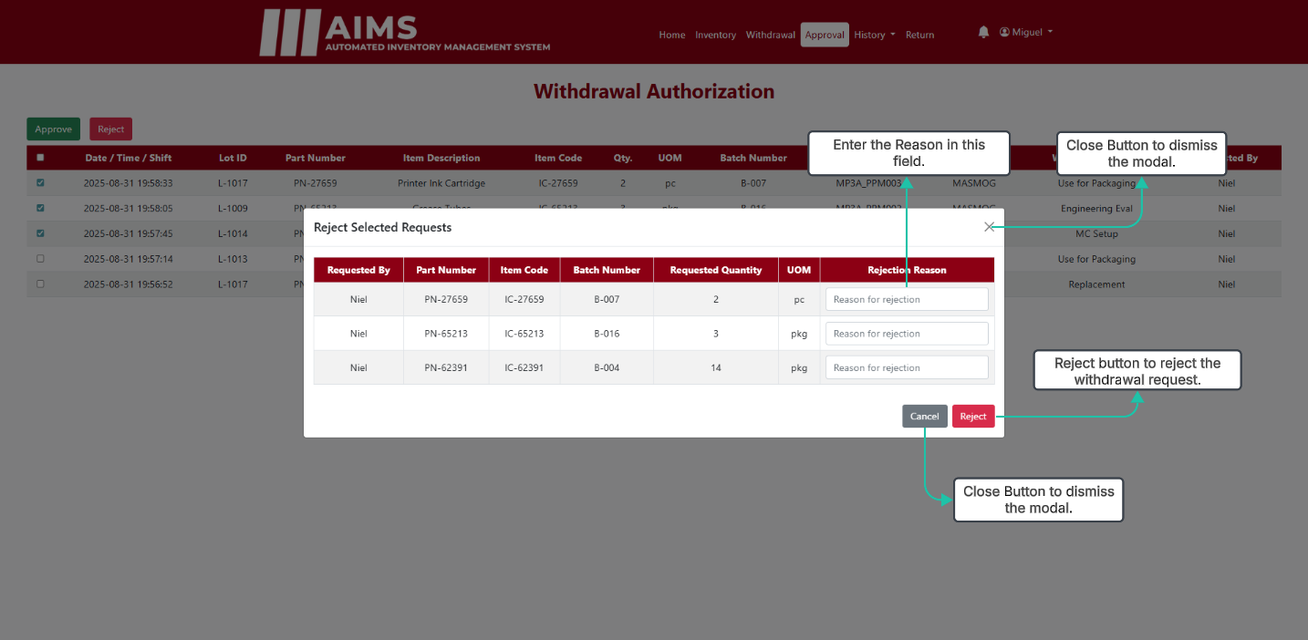
Approval (Reject Modal)

Slide 33
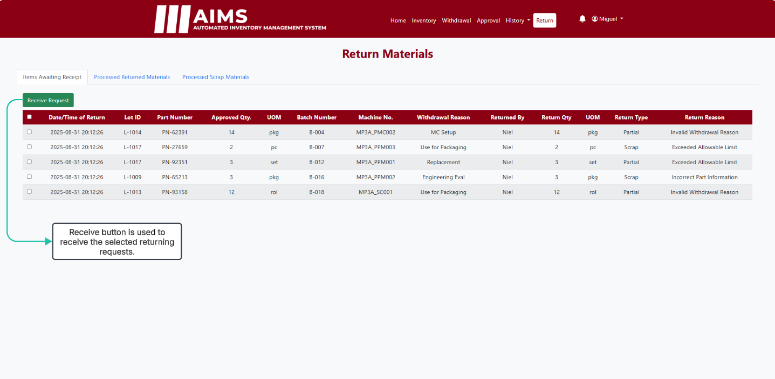
Scrap Awaiting Receipt

Slide 34
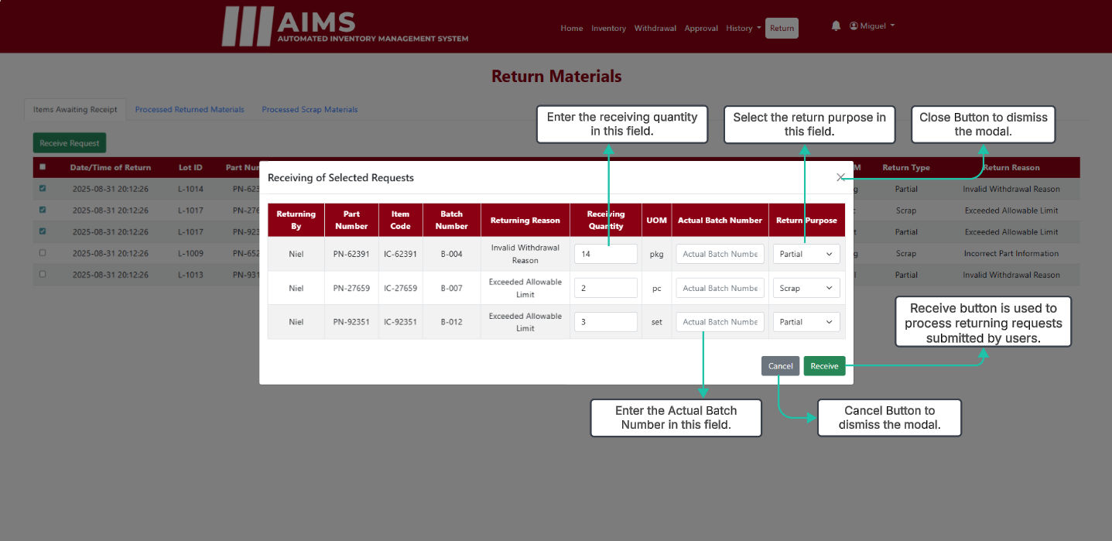
Scrap Awaiting Receipt

Slide 35
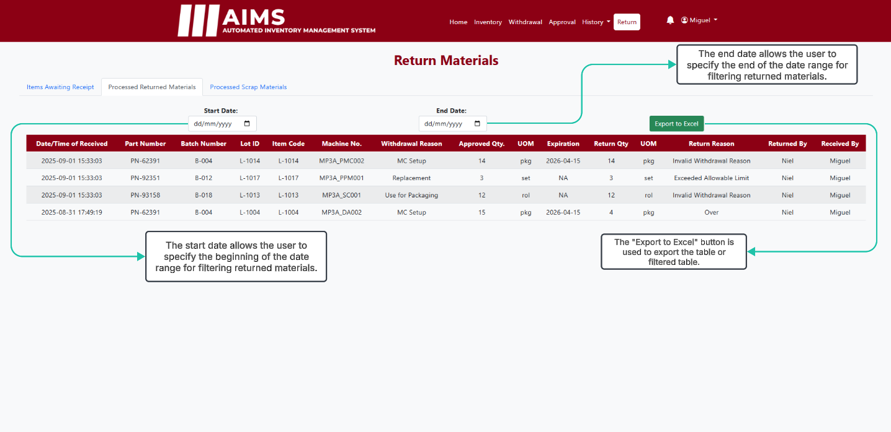
Processed Returned Items

Slide 36
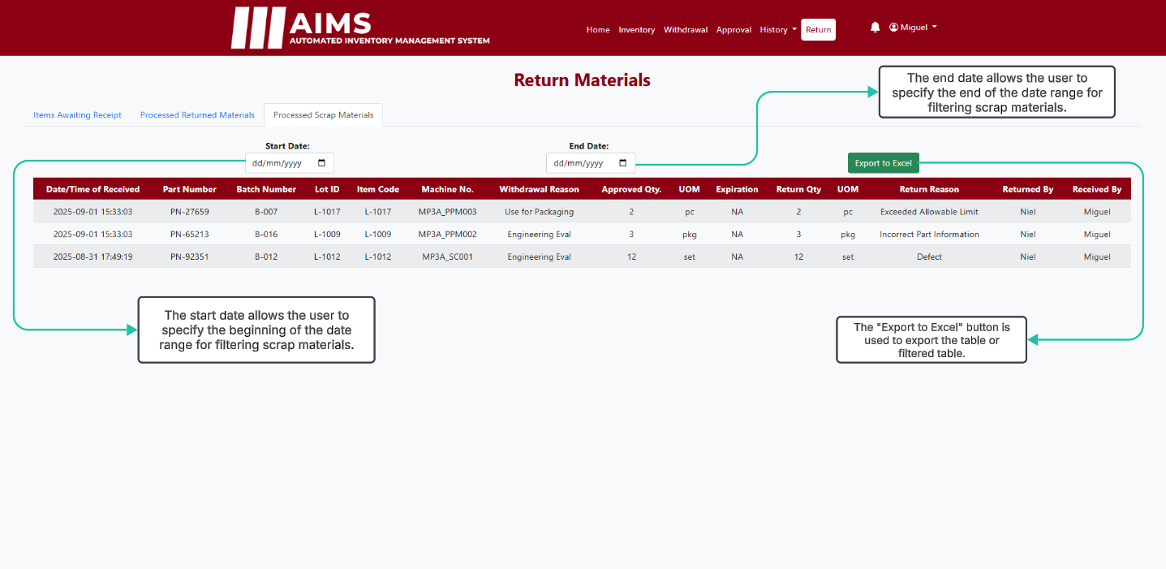
Processed Scrap Items

Slide 37
SUPERVISOR / MANAGER MODULE

Slide 38
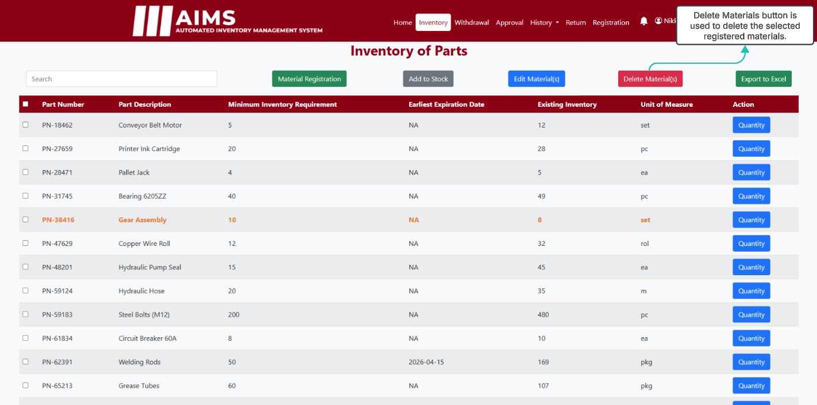
Inventory

Slide 39
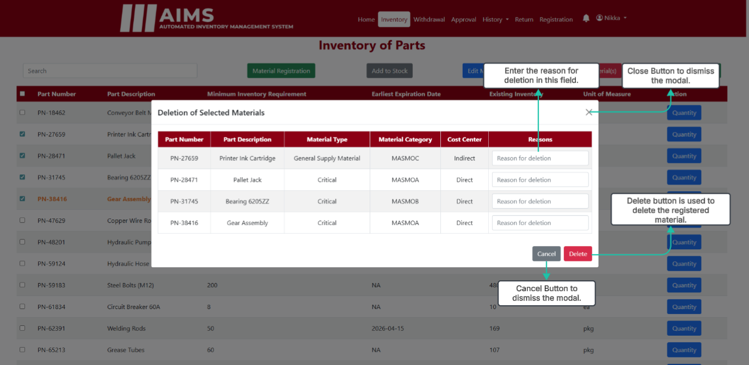
Inventory (Delete Modal)

Slide 40
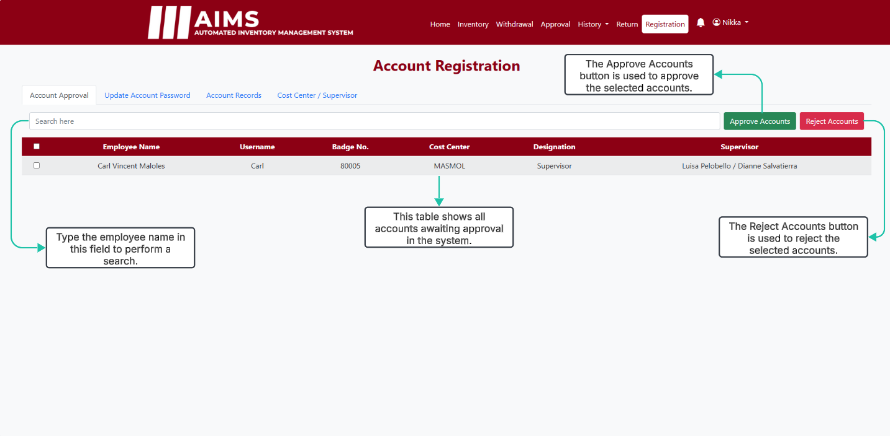
Account Approval

Slide 41
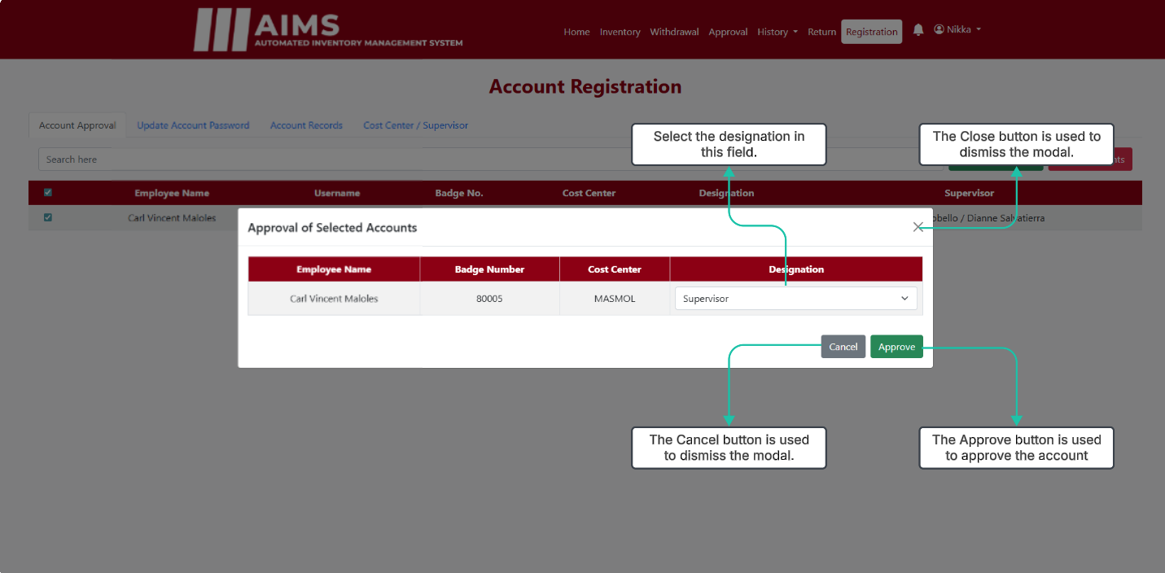
Account Approval (Approval Modal)

Slide 42
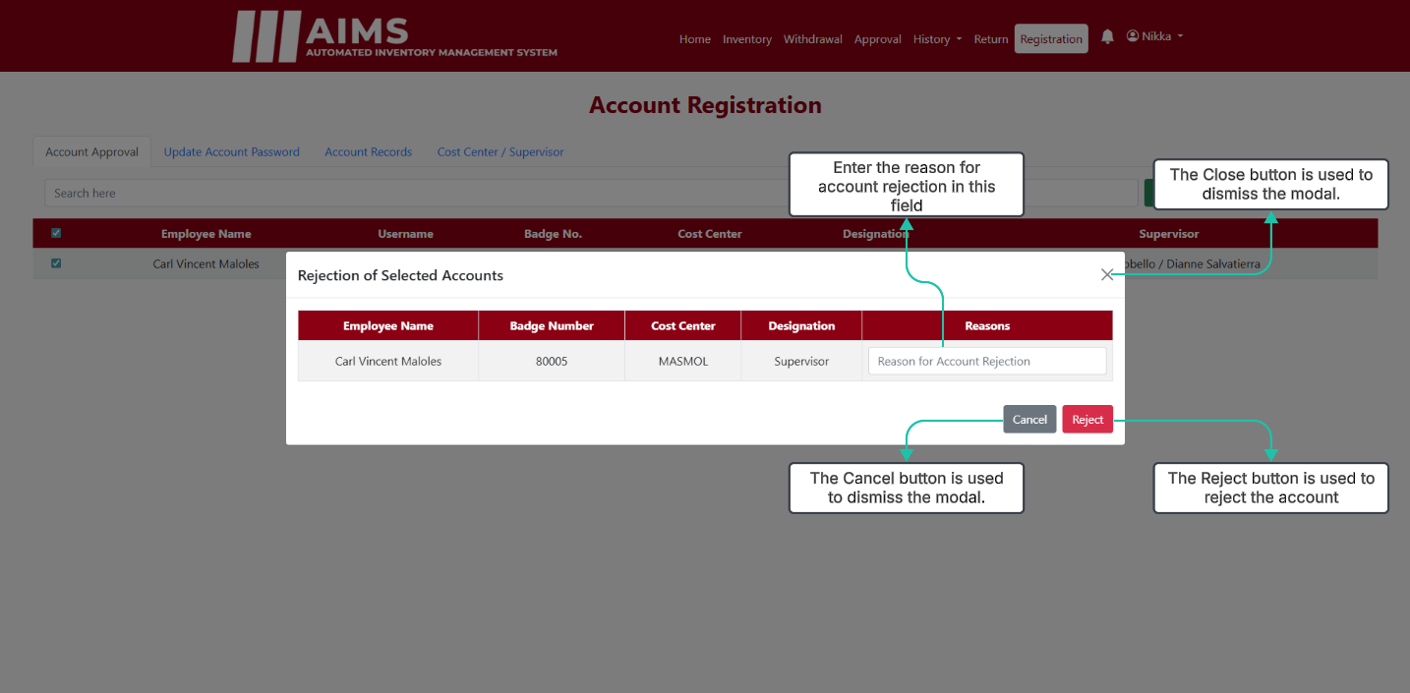
Account Approval (Rejection Modal)

Slide 43
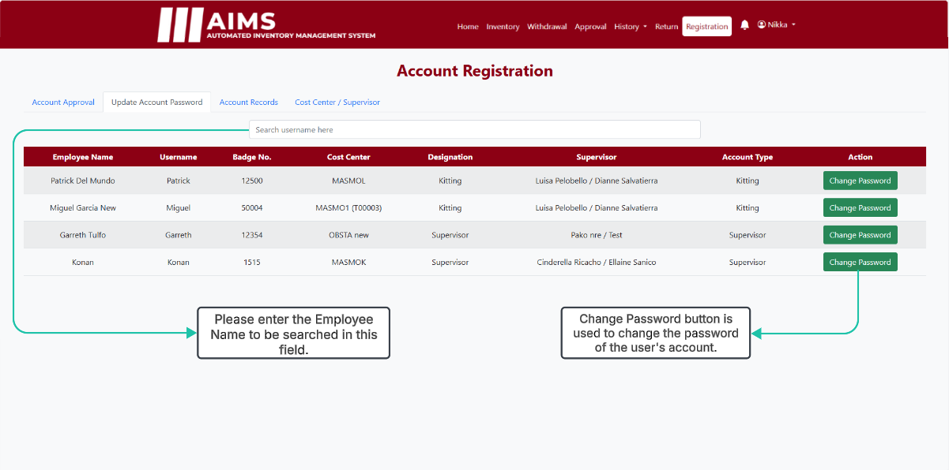
Update Account Password

Slide 44
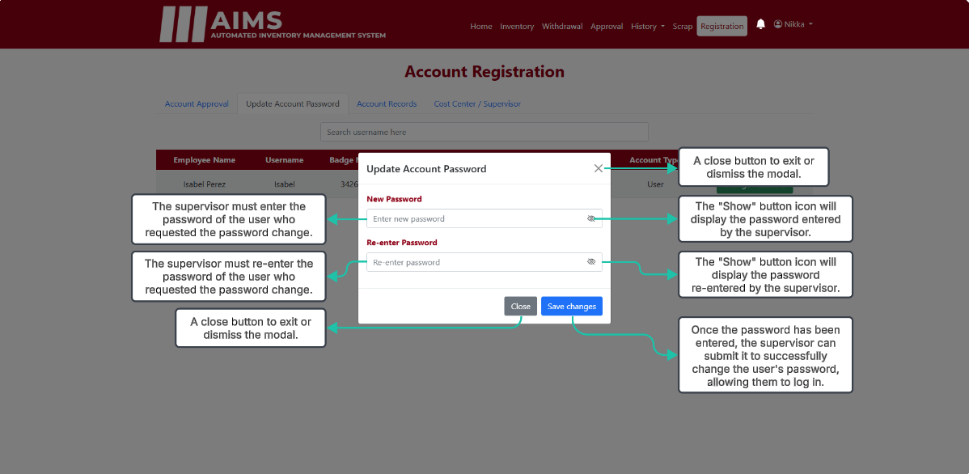
Change Password

Slide 45
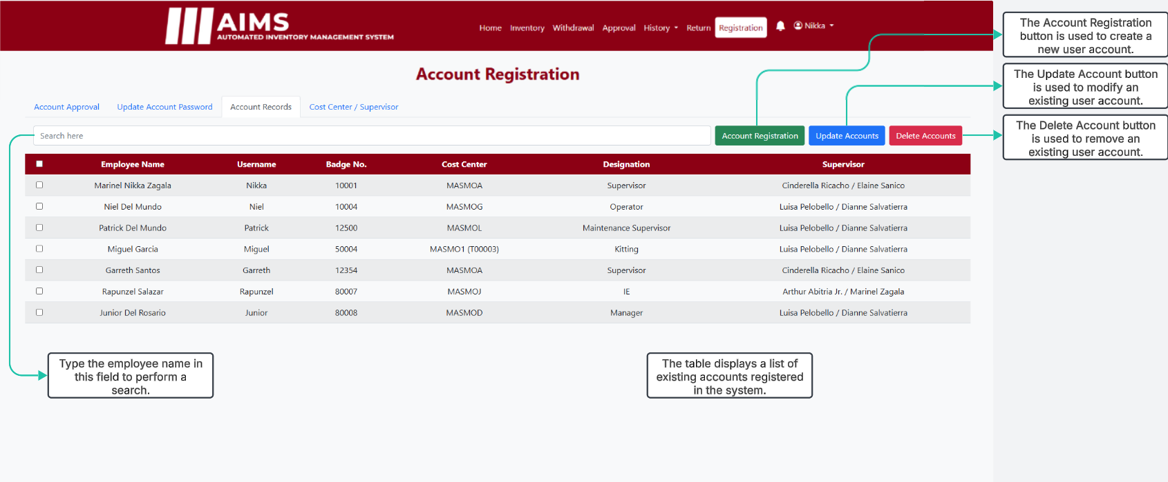
Account Records

Slide 46
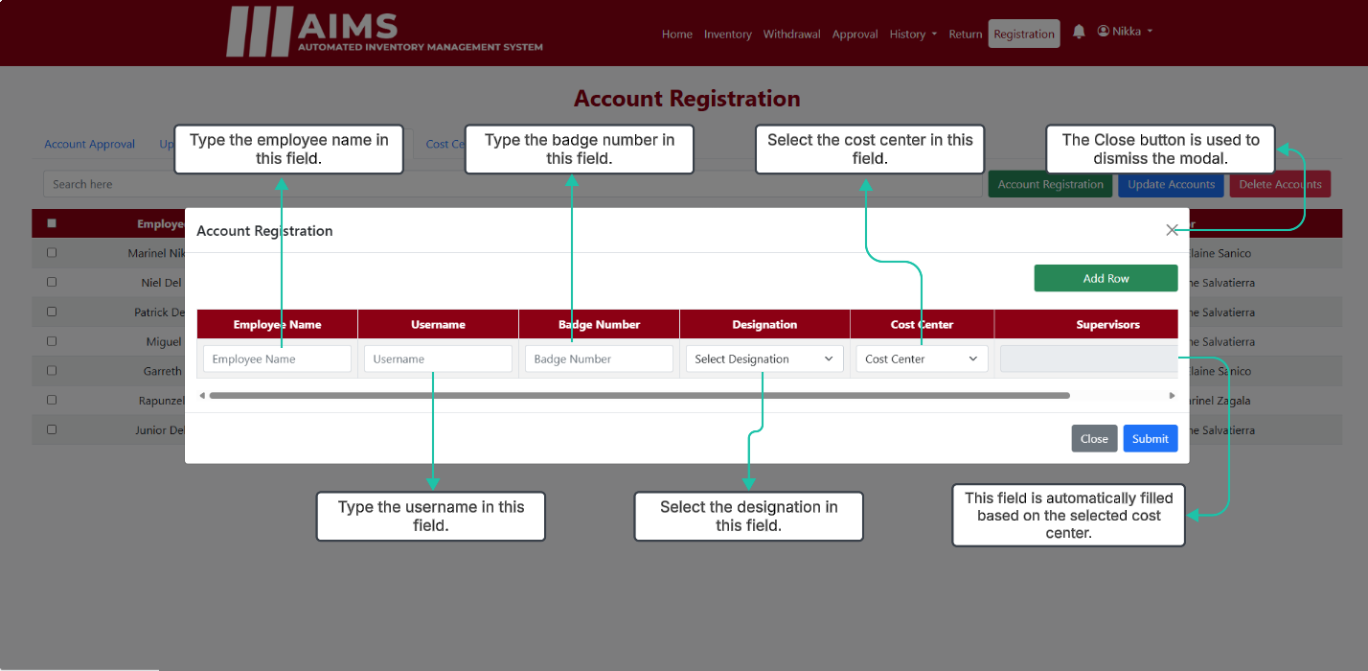
Register Account (Registration)

Slide 47
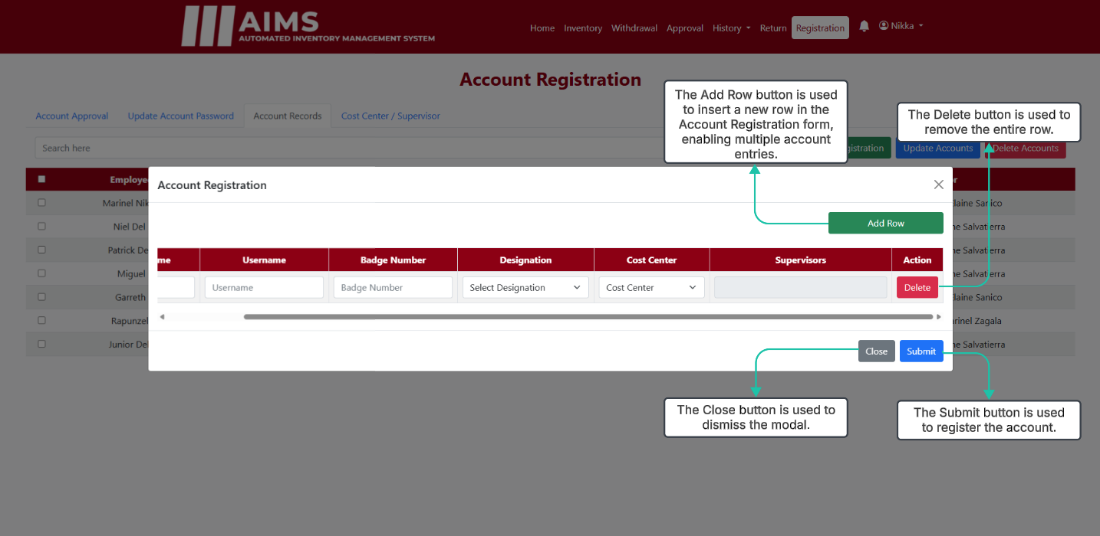
Register Account (Registration)

Slide 48
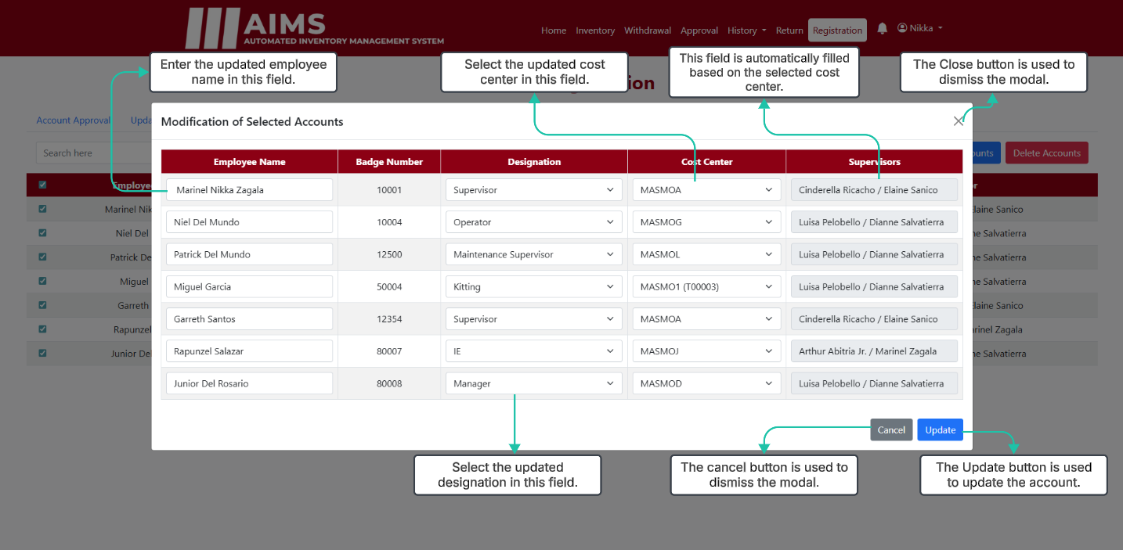
Register Account (Modification)

Slide 49
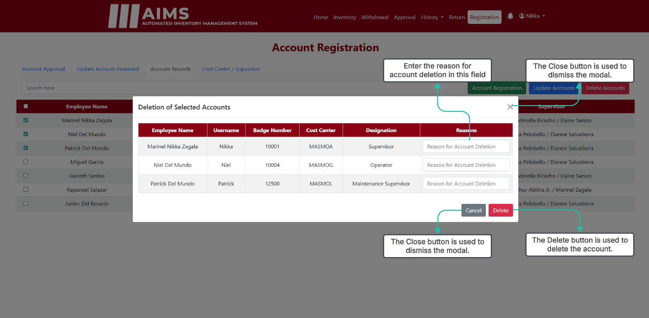
Register Account (Deletion)

Slide 50
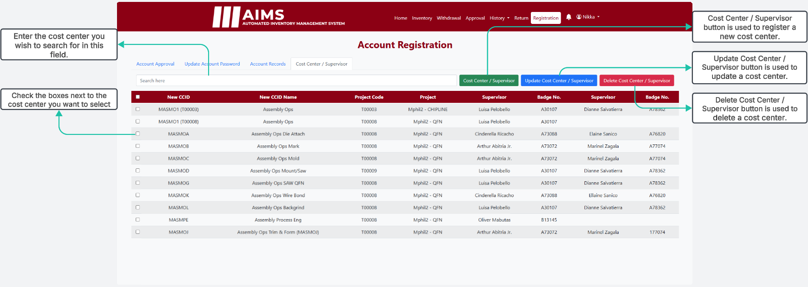
Cost Center / Supervisor

Slide 51
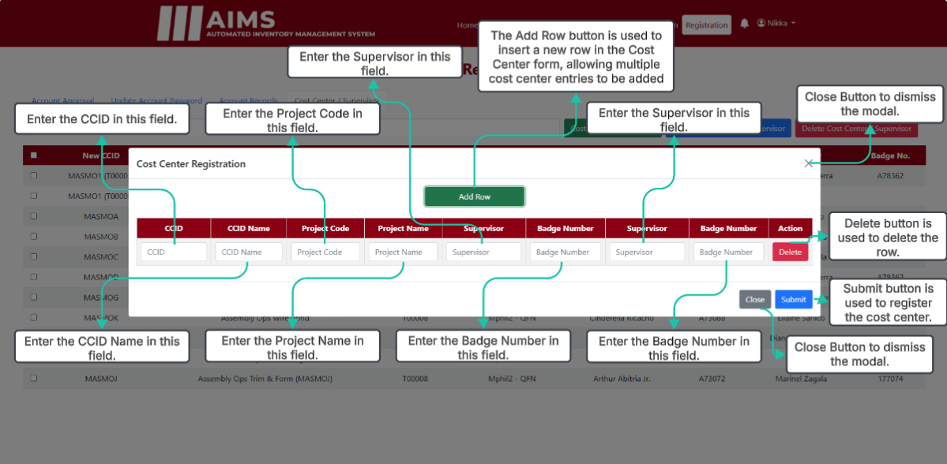
Cost Center Creation

Slide 52
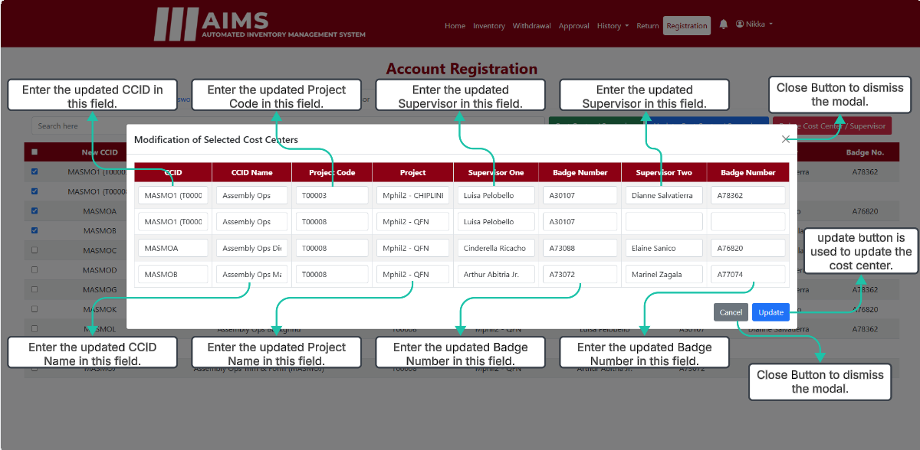
Cost Center Update Modal

Slide 53
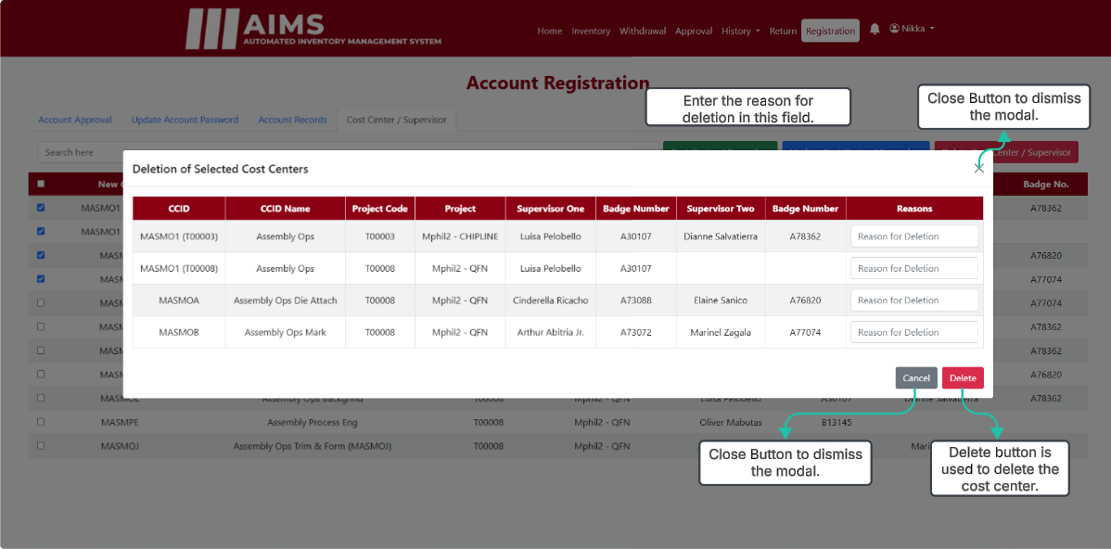
Cost Center Delete Modal

